Slide 1
Section 4: Implementation of Finite Element Analysis – Other Elements
Quadrilateral Elements
Higher Order Triangular Elements
Isoparametric Elements

Slide 2
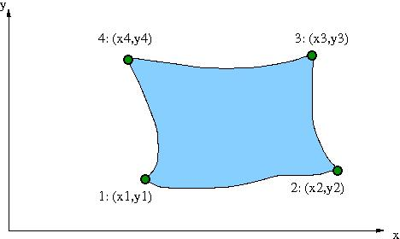
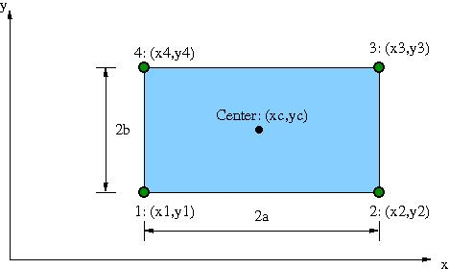
Section 4.1: Quadrilateral Elements
Refers in general
to any four-sided,
2D element.
We will start by
considering rectangular
elements with sides
parallel to coordinate
axes. (Thickness = h)

Slide 3
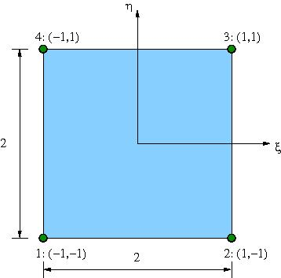
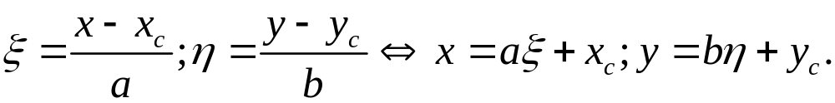
4.1: Quadrilateral Elements (cont.)
Normalized Element Geometry –
“Standard” setting
for calculations:
Mapping between real and normalized coordinates:

Slide 4
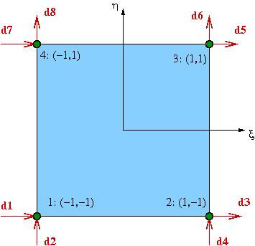
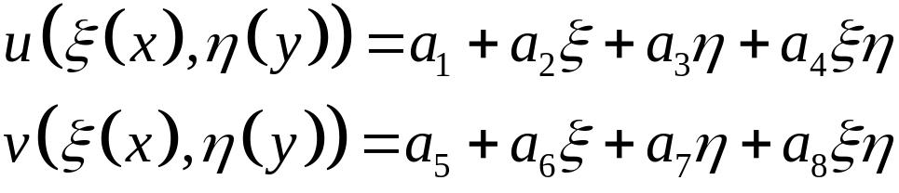
4.1: Quadrilateral Elements (cont.)
First Order Rectangular Element (Bilinear Quad):
4 nodes; 2 translational
d.o.f. per node.
Displacements interpolated as follows:
“Bilinear terms” – implies that all shape functions are products of linear functions of x and y.

Slide 5
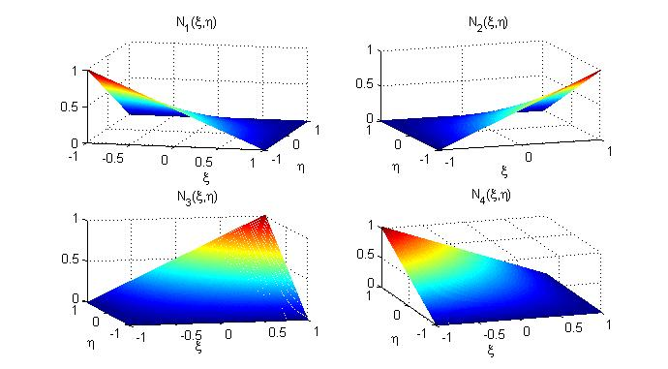
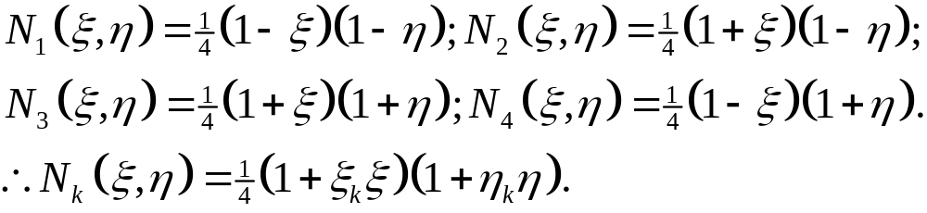
4.1: Quadrilateral Elements (cont.)
Shape Functions:

Slide 6
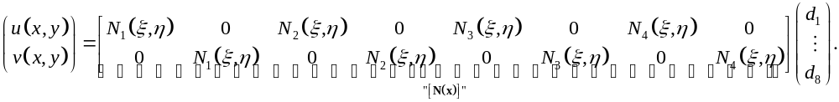
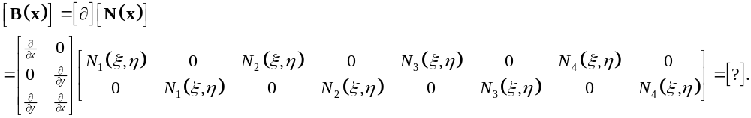
4.1: Quadrilateral Elements (cont.)
Displacement interpolation becomes:
Need to compute [B] matrix:

Slide 7
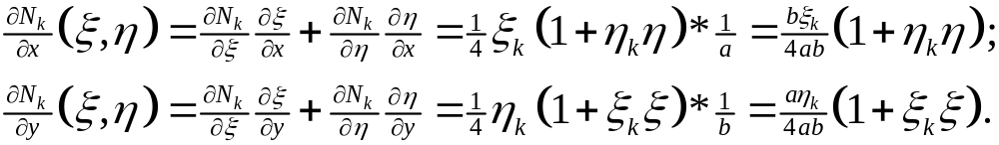
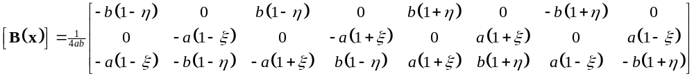
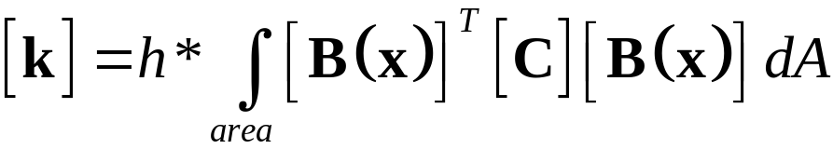
4.1: Quadrilateral Elements (cont.)
Chain rule:
Resulting [B(x)] matrix:
Recall general expression for [k]:
0
0
Express in terms of ξ and η!

Slide 8
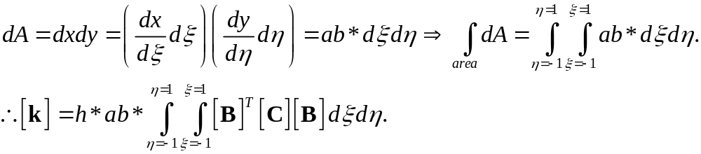
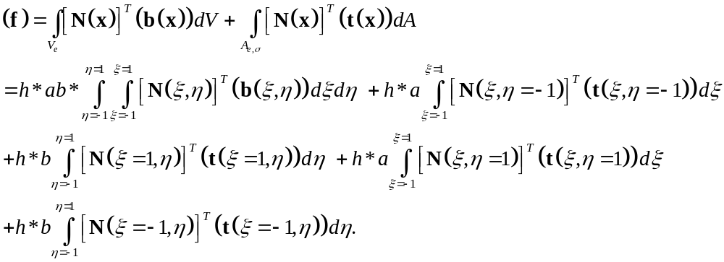
4.1: Quadrilateral Elements (cont.)
  Can show that
  Can also show that
Everything in terms of ξ and η!

Slide 9
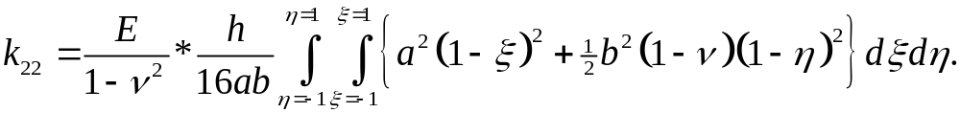
4.1: Quadrilateral Elements (cont.)
Gauss Quadrature:
Let’s take a closer look at one of the integrals for the element stiffness matrix (assume plane stress):
Can be solved exactly, but for various reasons FEA prefers to evaluate integrals like this approximately:
  Historically, considered more efficient and reduced coding errors.
  Only possible approach for isoparametric elements.
  Can actually improve performance in certain cases!

Slide 10
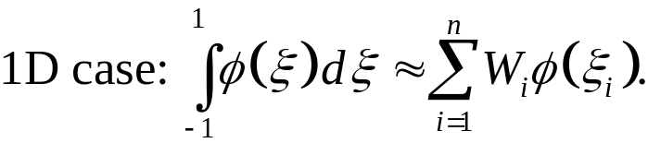
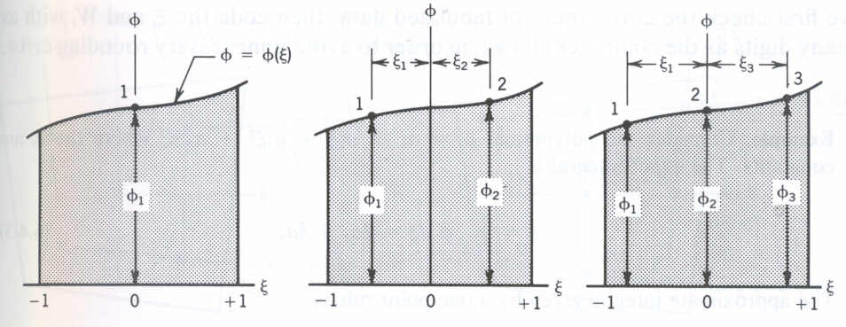
4.1: Quadrilateral Elements (cont.)
Gauss Quadrature:
Idea: approximate integral by a sum of function values at predetermined points with optimal weights –
n = order of quadrature; determines accuracy of integral.
(Note: any polynomial of order 2n-1 can be integrated exactly using nth order Gauss quadrature.)
weights = known constants, depend on n
Gauss points = known locations, depend on n

Slide 11
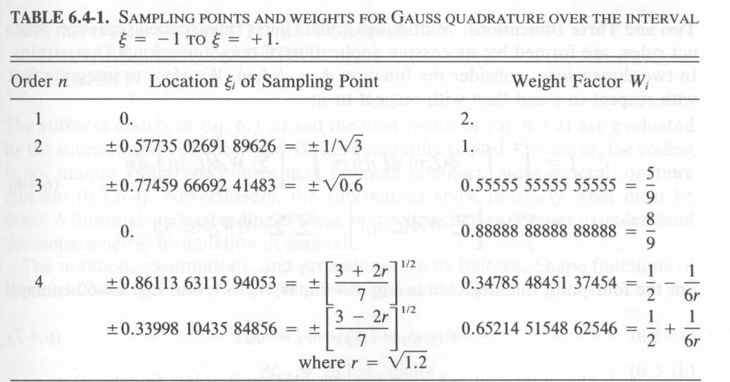
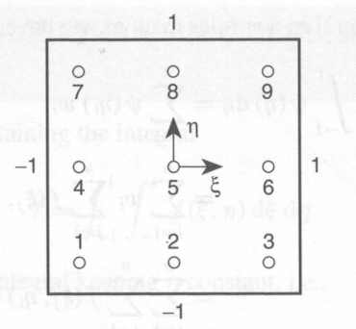
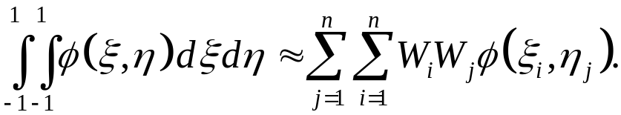
4.1: Quadrilateral Elements (cont.)
Gauss Quadrature:
Have tables for weights and Gauss points:
2D case handled as two 1D cases:

Slide 12
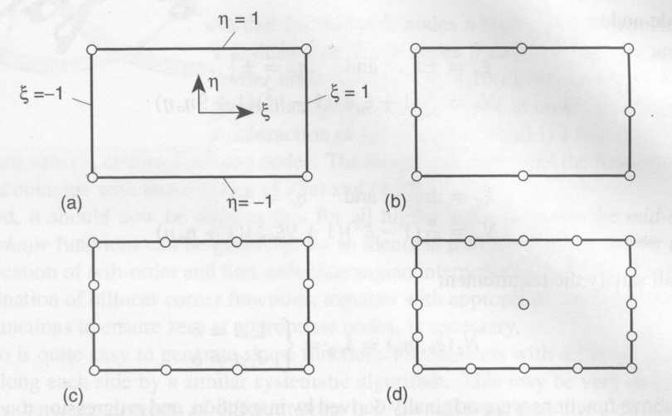
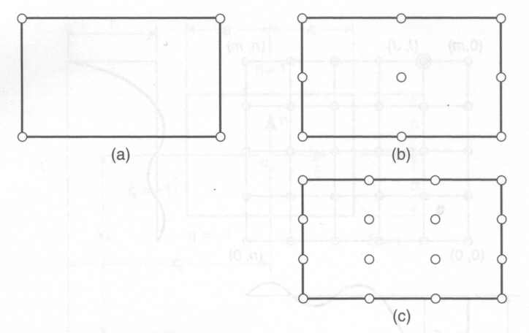
4.1: Quadrilateral Elements (cont.)
Higher Order Rectangular Elements
More nodes; still 2 translational d.o.f. per node.
“Higher order” ⇒ higher degree of complete polynomial contained in displacement approximations.
Two general “families” of such elements:
Serendipity
Lagrangian

Slide 13
4.1: Quadrilateral Elements (cont.)
Lagrangian Elements:
Order n element has (n+1)² nodes arranged in square-symmetric pattern – requires internal nodes.
Shape functions are products of nth order polynomials in each direction. (“biquadratic”, “bicubic”, …)
Bilinear quad is a Lagrangian element of order n = 1.

Slide 14

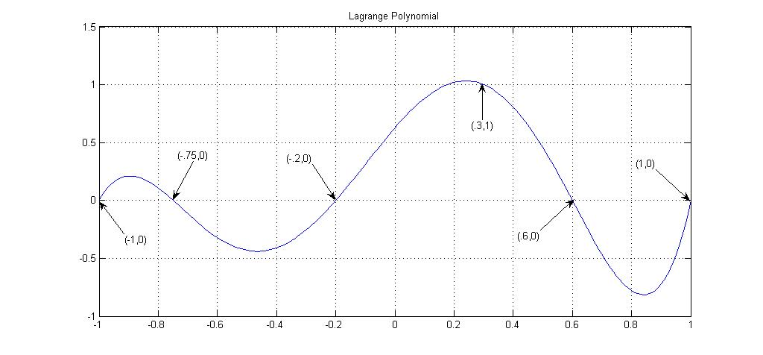
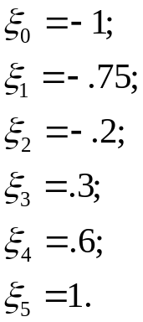
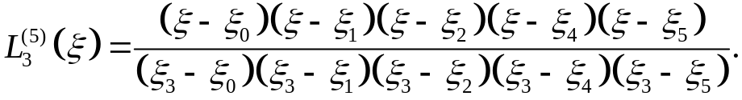
4.1: Quadrilateral Elements (cont.)
Lagrangian Shape Functions:
Uses a procedure that automatically satisfies the Kronecker delta property for shape functions.
  Consider 1D example of 6 points; want function = 1 at and function = 0 at other designated points:

Slide 15
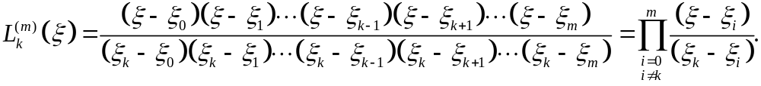
4.1: Quadrilateral Elements (cont.)
Lagrangian Shape Functions:
Can perform this for any number of points at any designated locations.
No ξ-ξ_{k} term!
Lagrange polynomial
of order m
at node k

Slide 16
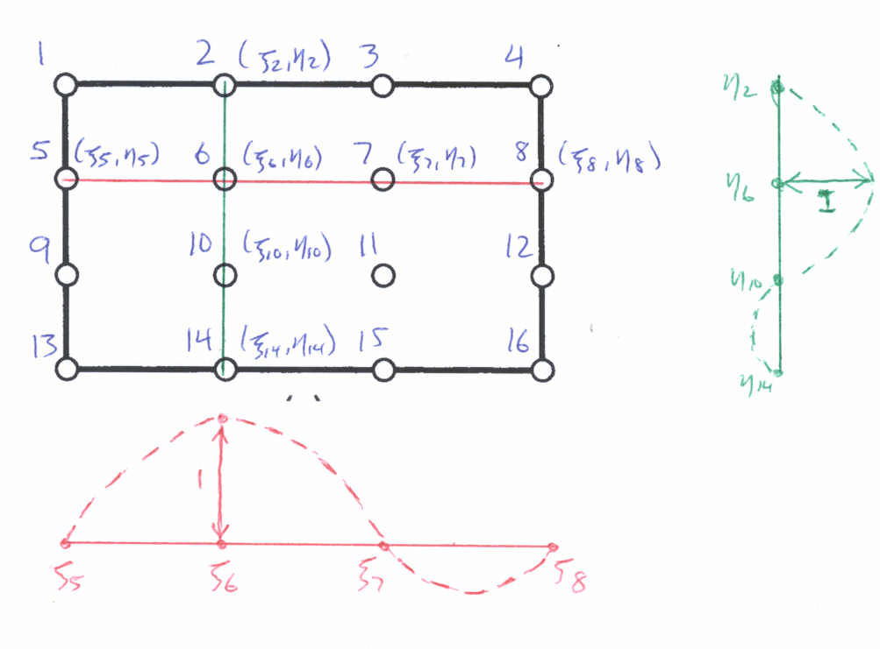
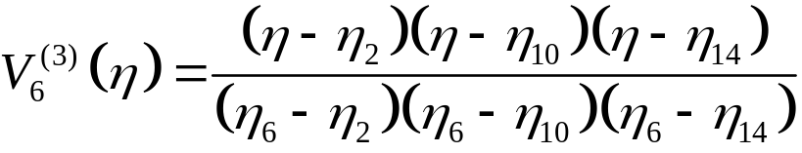
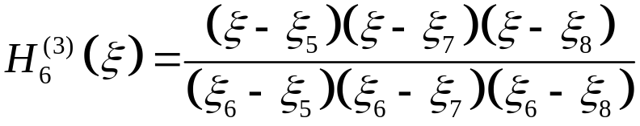

4.1: Quadrilateral Elements (cont.)
Lagrangian Shape Functions:
  Use this procedure in two directions at each node:

Slide 17
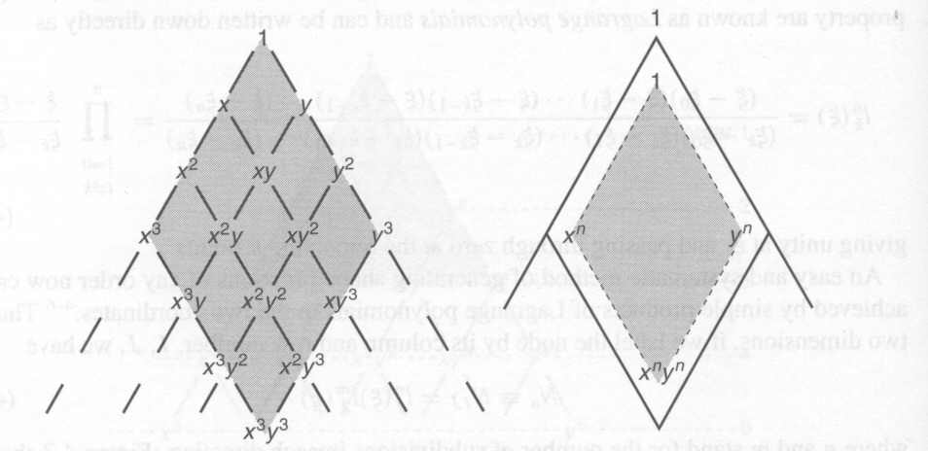
4.1: Quadrilateral Elements (cont.)
Notes on Lagrangian Elements:
Once shape functions have been identified, there are no procedural differences in the formulation of higher order quadrilateral elements and the bilinear quad.
Pascal’s triangle for the Lagrangian quadrilateral elements:
3 x 3
n x n

Slide 18
4.1: Quadrilateral Elements (cont.)
Serendipity Elements:
In general, only boundary nodes – avoids internal ones.
Not as accurate as Lagrangian elements.
However, more efficient than Lagrangian elements and avoids certain types of instabilities.

Slide 19
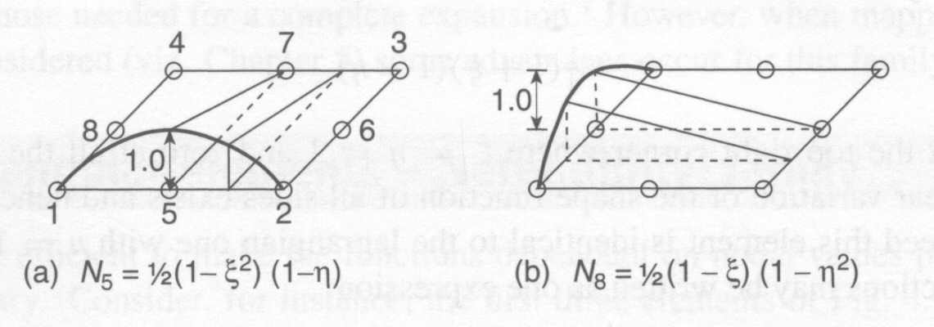
4.1: Quadrilateral Elements (cont.)
Serendipity Shape Functions:
Shape functions for mid-side nodes are products of an
nth order polynomial parallel to side and a linear function perpendicular to the side.
  E.g., quadratic serendipity element:

Slide 20



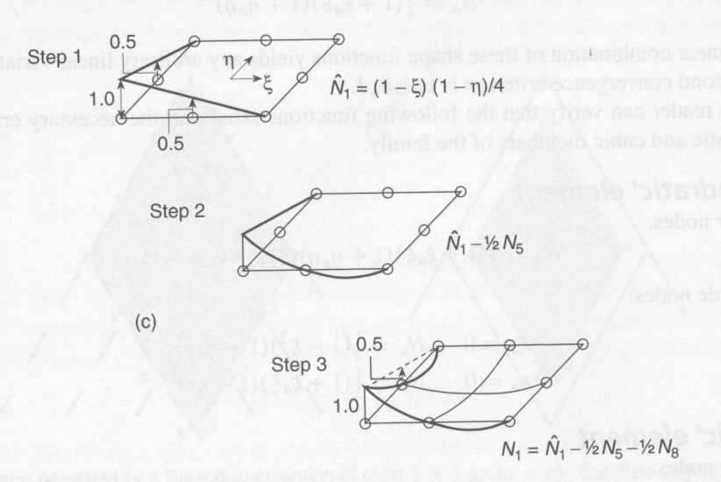
4.1: Quadrilateral Elements (cont.)
Shape functions for corner nodes are modifications of the shape functions of the bilinear quad.
  Step #1: start with appropriate bilinear quad shape function, .
  Step #2: subtract out mid-side shape function N₅ with appropriate
  weight
  Step #3: repeat Step #2 using mid-side shape function N₈ and weight

Slide 21
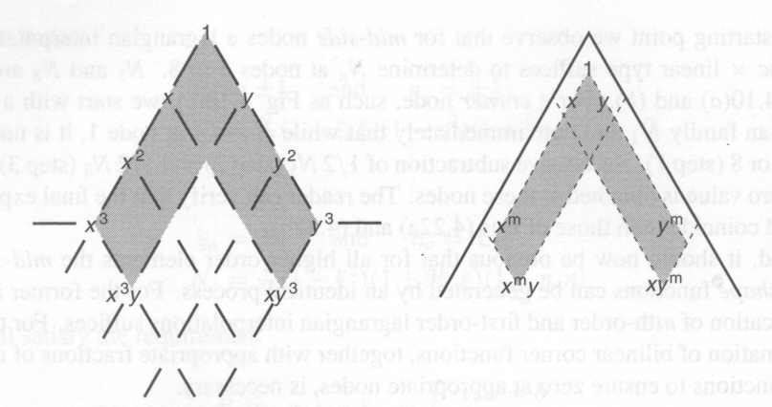
4.1: Quadrilateral Elements (cont.)
Notes on Serendipity Elements:
Once shape functions have been identified, there are no procedural differences in the formulation of higher order quadrilateral elements and the bilinear quad.
Pascal’s triangle for the serendipity quadrilateral elements:
3 x 3
m x m

Slide 22
4.1: Quadrilateral Elements (cont.)
Zero-Energy Modes (Mechanisms; Kinematic Modes) –
Instabilities for an element (or group of elements) that produce deformation without any strain energy.
Typically caused by using an inappropriately low order of Gauss quadrature.
If present, will dominate the deformation pattern.
Can occur for all 2D elements except the CST.

Slide 23
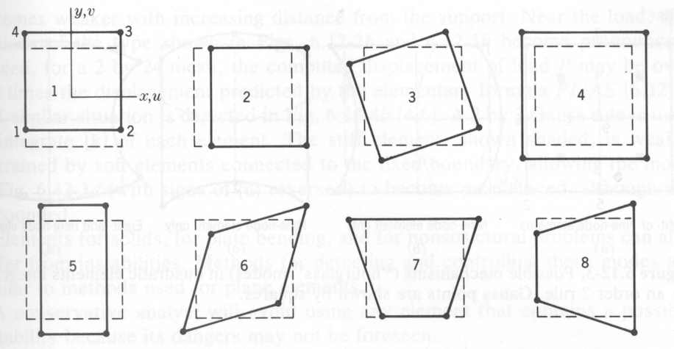
4.1: Quadrilateral Elements (cont.)
Zero-Energy Modes –
Deformation modes for a bilinear quad:
  #1, #2, #3 = rigid body modes; can be eliminated by proper constraints.
  #4, #5, #6 = constant strain modes; always have nonzero strain energy.
  #7, #8 = bending modes; produce zero strain at origin.

Slide 24
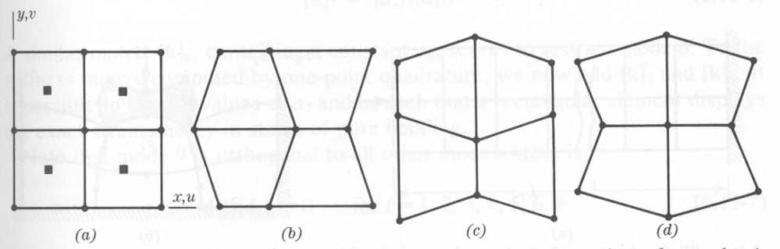
4.1: Quadrilateral Elements (cont.)
Zero-Energy Modes –
Mesh instability for bilinear quads using order 1 quadrature:
“Hourglass modes”

Slide 25
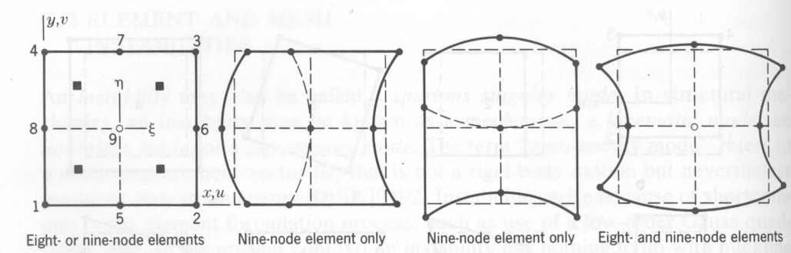
4.1: Quadrilateral Elements (cont.)
Zero-Energy Modes –
Element instability for quadratic quadrilaterals using 2x2 Gauss quadrature:
“Hourglass modes”

Slide 26
4.1: Quadrilateral Elements (cont.)
Zero-Energy Modes –
How can you prevent this?
  Use higher order Gauss quadrature in formulation.
  Can artificially “stiffen” zero-energy modes via penalty functions.
  Avoid elements with known instabilities!

Slide 27
Section 4: Implementation of Finite Element Analysis – Other Elements
Quadrilateral Elements
Isoparametric Elements
Higher Order Triangular Elements
Note: any type of geometry can be used for isoparametric elements;
we will only look at quadrilateral elements.

Slide 28
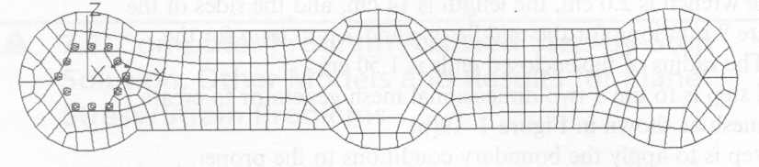
Section 4.2: Isoparametric Elements
For various reasons, need elements that do not “fit” the standard geometry.
Curved boundaries
Transition regions

Slide 29
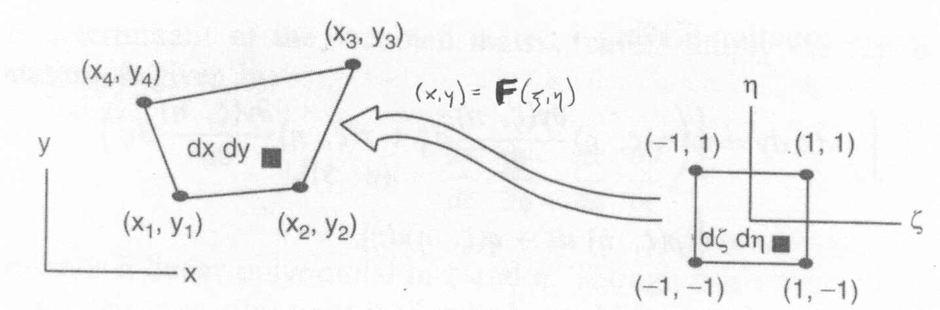
4.2: Isoparametric Elements (cont.)
Problem: How do you map a general quadrilateral onto the normalized geometry?

Slide 30
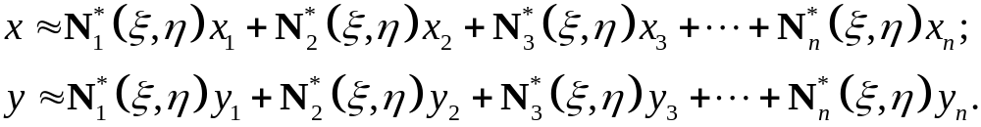

4.2: Isoparametric Elements (cont.)
Idea: Approximate the mapping using “shape functions”.
Require to have Kronecker delta property.
not required to be the actual shape functions of the element; n can be as large or as small as you want.

Slide 31
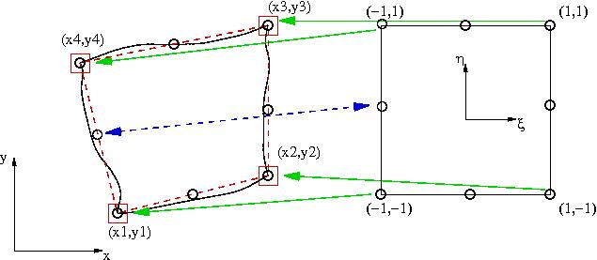
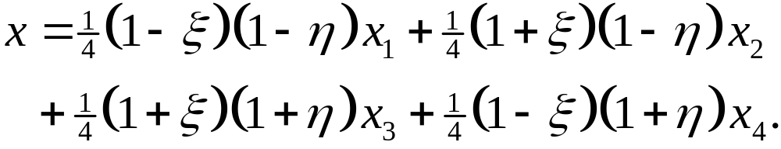
4.2: Isoparametric Elements (cont.)
Approximate “serendipity element” shown using bilinear quad shape functions and approximation points at corners

Slide 32
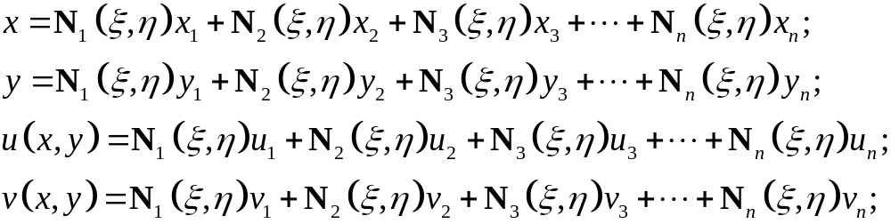
4.2: Isoparametric Elements (cont.)
For an isoparametric element, the number of approximation points equals the actual number of nodes for the element; also, the approximation functions are the actual shape functions for the element:
  If # of approx. pts. > # of nodes, element is called superparametric; if # of approx. pts. < # of nodes,
  element is called subparametric.

Slide 33
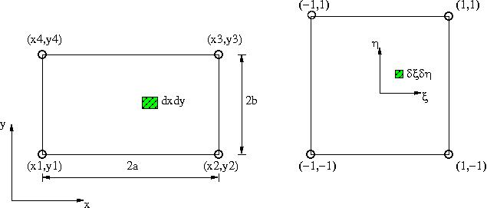
4.2: Isoparametric Elements (cont.)
Formulating an Isoparametric Element:
Recall the formulation of “standard” bilinear quad:
How does this work for an isoparametric element?

Slide 34
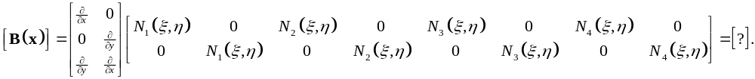
4.2: Isoparametric Elements (cont.)
Formulating an Isoparametric Element:
Calculating the [B] matrix (assume isoparametric bilinear quad element):
Need to apply the chain rule!

Slide 35
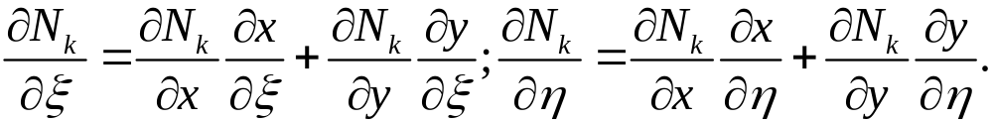
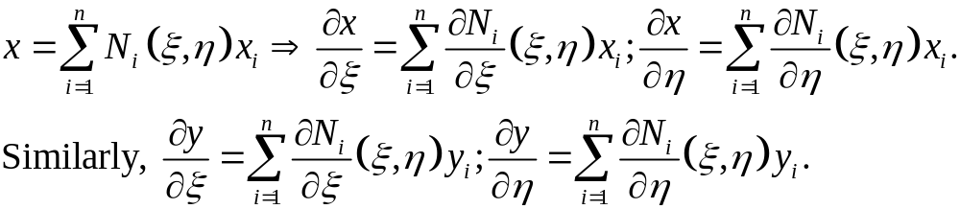
4.2: Isoparametric Elements (cont.)
Formulating an Isoparametric Element:
Chain rule: compute inverse rule first –
Using the approximate mapping:

Slide 36
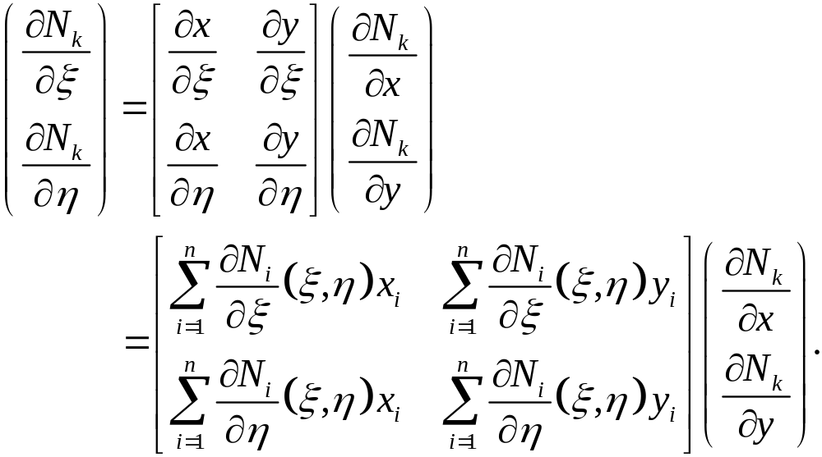
4.2: Isoparametric Elements (cont.)
Formulating an Isoparametric Element:
Put all of this together –
The Jacobian matrix [J] of the mapping.

Slide 37
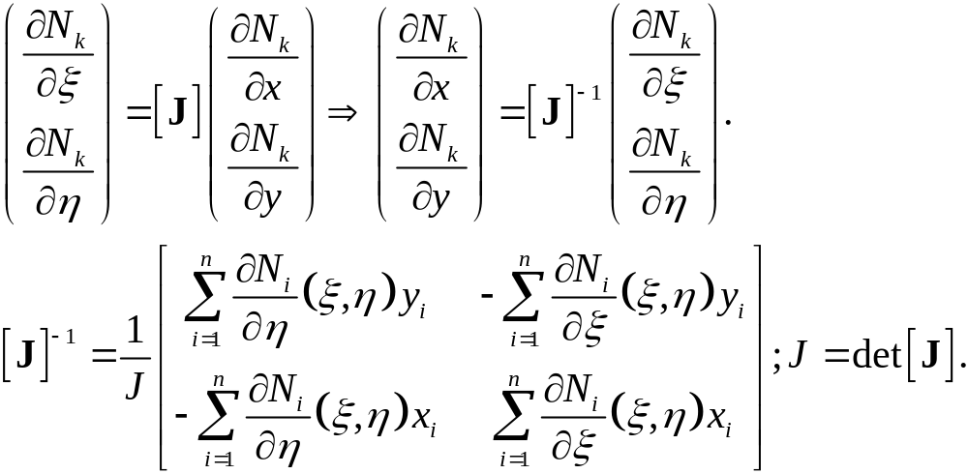
4.2: Isoparametric Elements (cont.)
Formulating an Isoparametric Element:
Can now compute the regular chain rule –
“Jacobian” of the mapping

Slide 38

4.2: Isoparametric Elements (cont.)
Formulating an Isoparametric Element:
J is a (nonconstant) scaling factor that relates area in original geometry to area in normalized geometry; can show that
For a well-defined mapping, J must have same sign at all points in normalized geometry.
Large variations in J imply highly distorted mappings – leads to badly formed elements.

Slide 39
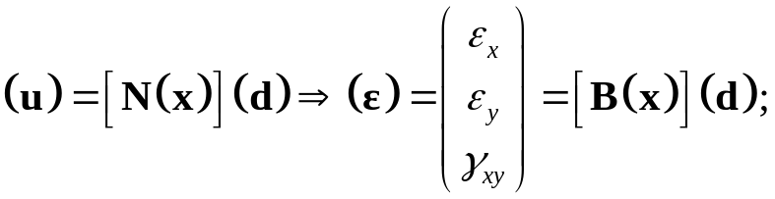

4.2: Isoparametric Elements (cont.)
Formulating an Isoparametric Element:
Calculating the [B] matrix:

Slide 40


4.2: Isoparametric Elements (cont.)
Calculating the element stiffness matrix:
Note: [B] is proportional to J⁻¹:
area scaling factor – polynomial function of (ξ,η)
In general, you are integrating ratios of polynomial functions, which typically don’t have exact integrals ⇒ use Gauss quadrature to evaluate!

Slide 41


4.2: Isoparametric Elements (cont.)
Calculating the element nodal forces:
Body force contribution:
Surface traction contribution:
What do you do with this?
What do you do with these?

Slide 42



4.2: Isoparametric Elements (cont.)
Converting body force and surface tractions:
Idea #0: If body force = constant and/or surface traction on
edge #k = constant, do nothing!
Idea #1: Use the isoparametric mapping to modify force functions:
Idea #2: Make an isoparametric approximation for the forces:

Slide 43




4.2: Isoparametric Elements (cont.)
Converting dℓ on edge #k:
In general:
On the given edge #k, :

Slide 44


4.2: Isoparametric Elements (cont.)
Thus, the contribution from surface tractions on edge #k is:
Note: unless i = k or i = k+1 !
Idea #1!

Slide 45


4.2: Isoparametric Elements (cont.)
Example: Formulating an Isoparametric Bilinear Quad –
Given: 4-node plane stress element has E = 30,000 ksi, ν = 0.25, h = 0.50 in, no body force, and surface traction shown.
Required: Find [k] and (f). Use 2 x 2 Gauss quadrature for [k].

Slide 46


4.2: Isoparametric Elements (cont.)
Solution:
Isoparametric mapping:
Jacobian matrix and Jacobian:

Slide 47

4.2: Isoparametric Elements (cont.)
Solution:
[B] matrix:

Slide 48

4.2: Isoparametric Elements (cont.)
Solution:
[k] matrix:

Slide 49



4.2: Isoparametric Elements (cont.)
Solution:
2 x 2 Gauss quadrature:

Slide 50
4.2: Isoparametric Elements (cont.)
Solution:
Element nodal forces:

